Slide 1
Smart Toaster Ovens
William Hunter
Barhon Carter
Fayth Hawkins
Otoo Bobbie
Patrice Harris
wkins
Otoo Bobbie
Notes:
Basic intro: introduce group (4) w/ names and our choice of a smart toaster oven (15sec)
“Good evening, This is group 4’s modelling presentation on the dynamic system of a smart toaster oven. The group members are William Hunter, Barh…”

Slide 2

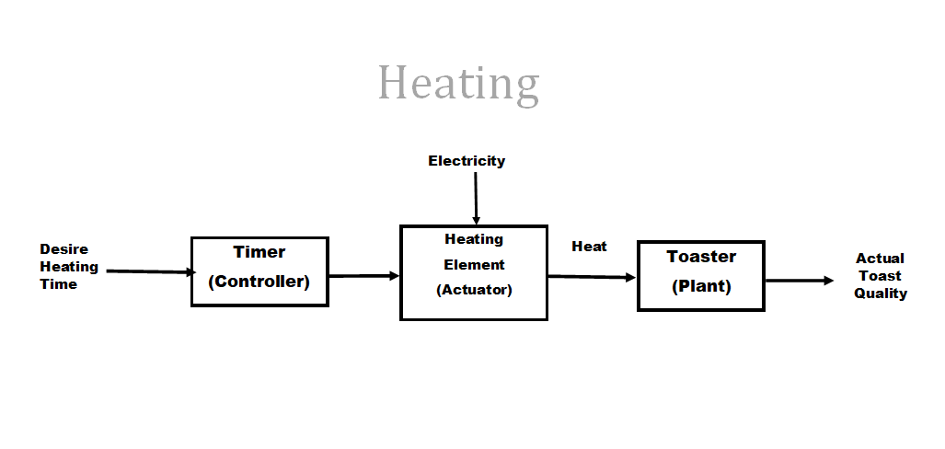
Open Loop System
Notes:
Basic overall statement that describes the open loop system for most common toasters(
“

Slide 3
What makes a toaster oven “Smart”
The toaster oven we have designed has many sensors on board to determine the optical wavelength of the item placed into it to match a desired “toast” level.
Furthermore, the device has bluetooth capabilities to indicate when the “plant” is completely to desired specifications. It does all of this by calculating the temperature and optical quality of the item. Several feedback lines along with several onboard microcontrollers work together to optimize the quality of the item, this prevents burning, wasted money, and even risk of fire.

Slide 4
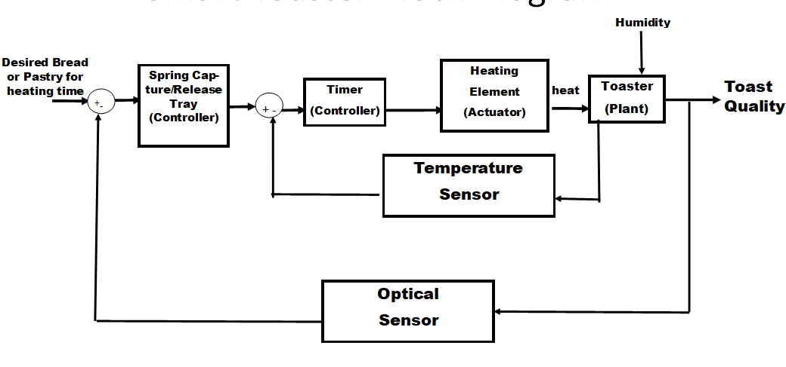
Smart Toaster Block Diagram
Notes:
This is our block diagram for fot the Smart toaster oven, As you can see we have our controllers would be the spring capture and the time with the heating element being the actuator and the oven as the plant. Our feedbacks are the temperature and optical sensors all leading to the toast quality

Slide 5
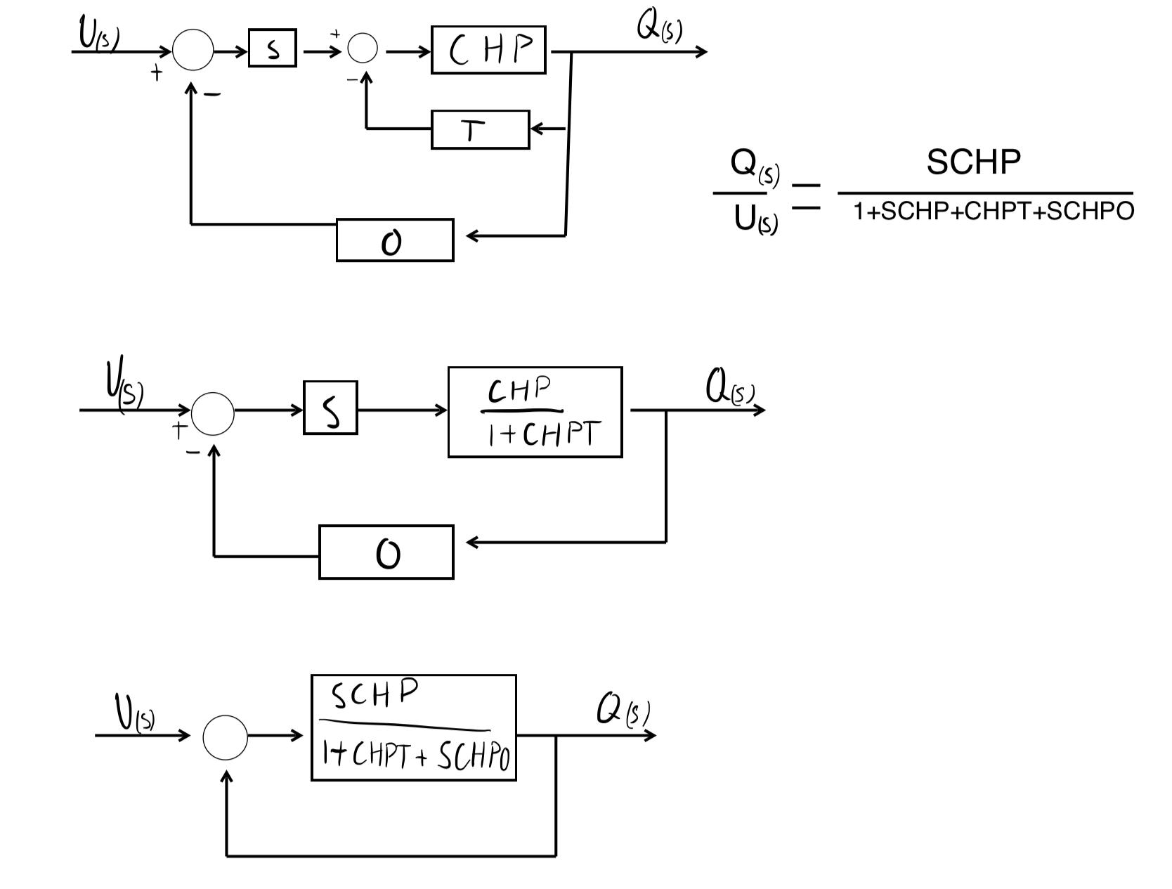
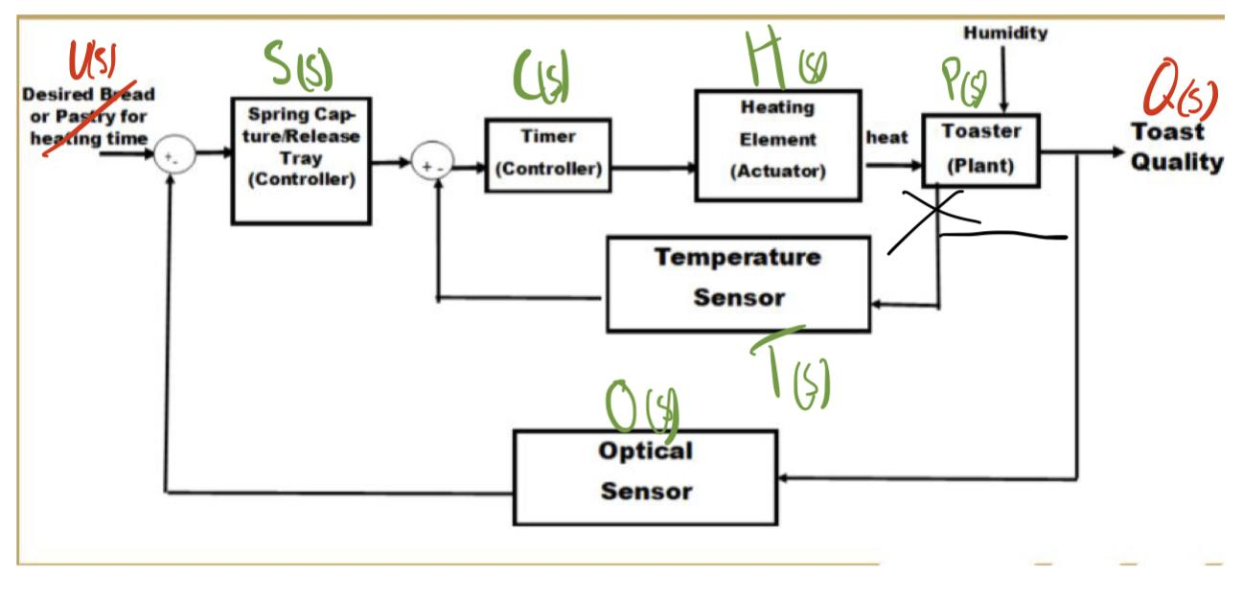
Transfer Function
Variable Reference
Notes:
To Find out transfer function we used the block diagram from the previous slide and used the block diagram transformations to be able to simplify the diagram into less parts to be able to find our transfer function. The left image is the breakdown of the transformation steps and the transfer function….(Say equation) The image on the Right is to is how we referenced our variables.

Slide 6
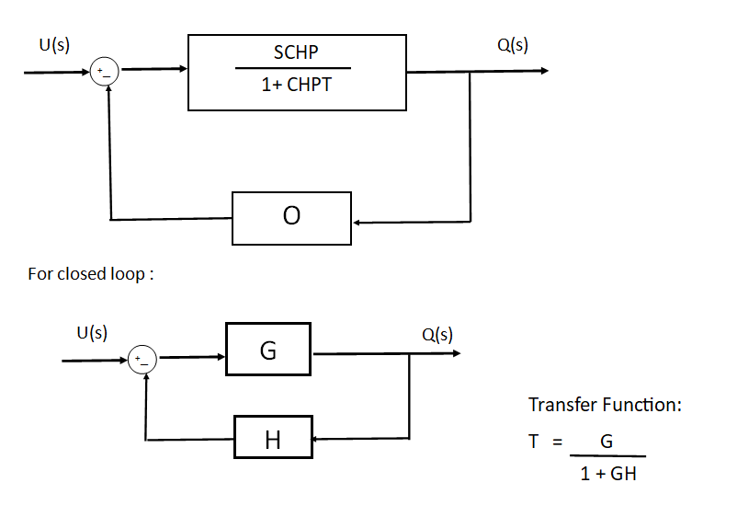
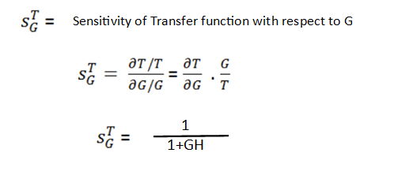
Sensitivity of Closed Loop
SENSITIVITY

Slide 7
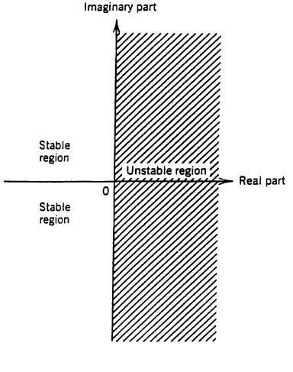
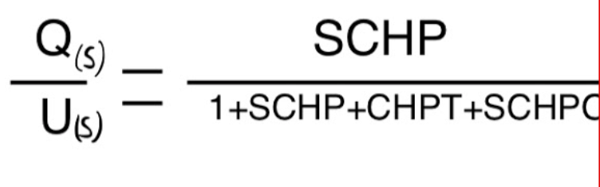
STABILITY
Transfer Function:
Stable if and only if all roots of the characteristic equation are negative or have negative real parts. Otherwise, the system is unstable.
Characteristics equation:
1+SCHP + CHPT + SCHPO = 0
System is stable.
Notes:
Notes: https://lewisgroup.uta.edu/ee4314/lectures/Lecture%204.pdf
**https://ieeexplore.ieee.org/stamp/stamp.jsp?tp=&arnumber=1084637
https://sites.chemengr.ucsb.edu/~ceweb/faculty/seborg/teaching/SEM_2_slides/Chapter%2011%20(11-23-04).pdf
**stablity starts on pg 43

Slide 8
Motivation
Initial Ideas and Thoughts
Create a new layer to older technology that is more efficient production wise, safer for users to handle, and has easier accessibility for different types of materials.
Design a platform that is formidable to the standard convection ovens in households.
Somehow connect this to an IoT platform similar to Amazon’s Alexa or Google home.
Notes:
“ The team’s initial thoughts and motivation for this project came from the different household control system that get overlook each and everyday. The toaster oven is an evolving appliance that is slowly taking its place in front of huge standard convection ovens found in most households. Another thought that pushed further interest was nested in IOT capabilities for future applications. The image of a smart house that is tied into different appliances via bluetooth, is something that controversial and seeable in the near future.”

Slide 9
Constraints of a Toaster Oven
The size and type of a piece of pastry or bread will burn in a simple open loop system. Different toasters by different brands can also have some feature issues like exterior warming, where the outside of the toaster gets extremely hot whilst the “bread” is cooking, or a slow warming feature, where the toaster takes a longer allotted time to warm up to the appropriate temperature needed to cook the item desired.
Notes:
When looking at the overall system there can be some design constraints for the smart toaster ovens. The size and type of a piece of pastry or bread will burn in a simple open loop system because there is no way to adjust the timing settings for the food.

Slide 10
Constraints of a Toaster Oven (continued)
When cooking on a “simple” or “smart” toaster, the constraints can cause varying outputs of the “toast” quality of the desired treat.
Overcooking
Undercooking
Cost
Environmental-Pollution
Burnt toast
Leftover crumbs
Social-Pollution controversy
Notes:
Toasters, in general, have an environmental impact. According to an article found in the New York Post, University of Texas at Austin did a case study on pollution of toasters. They advised that the release of steam from the cooked particles and crumbs in toasters can lead to being exposed to more pollution than a busy intersection. Having a door, a cleansing feature, and emptying the crumb tray will allow for a reduce in exposure and even allow comfort within the social constraint aspect.

Slide 11
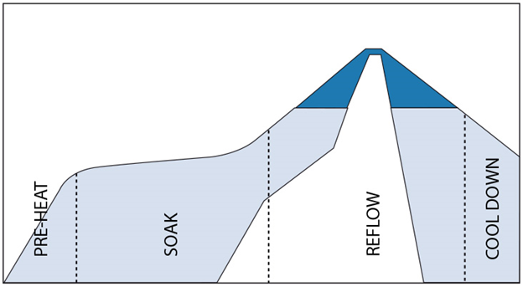
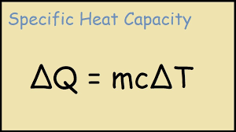
Diagram of the heating elements and heating modeling with graphs
A reflow oven allows you to mount small components to circuit boards. We will utilize this instead of an infrawave element. The below function shows the amount of heat developed by the element we will be using. The heat has to be brought up and tapered off repeatedly to avoid melting the solder, therefore, it can only go up to 225°c for a few seconds. The transfer function here would be T(s)/t(s) = Ae^(.001219t) This was calculated using the newtonian heating differential equation.
Notes:
The team and I decided to go with a reflow heating element since we needed to use a fiberglass motherboard with soldered on elements and sensors. The relow allows the solder to remain solid instead of melting, and based off of the graphical representation on the left I created the transfer function mentioned above. This period of heating and cooling will continue until the plant is fully complete.

Slide 12
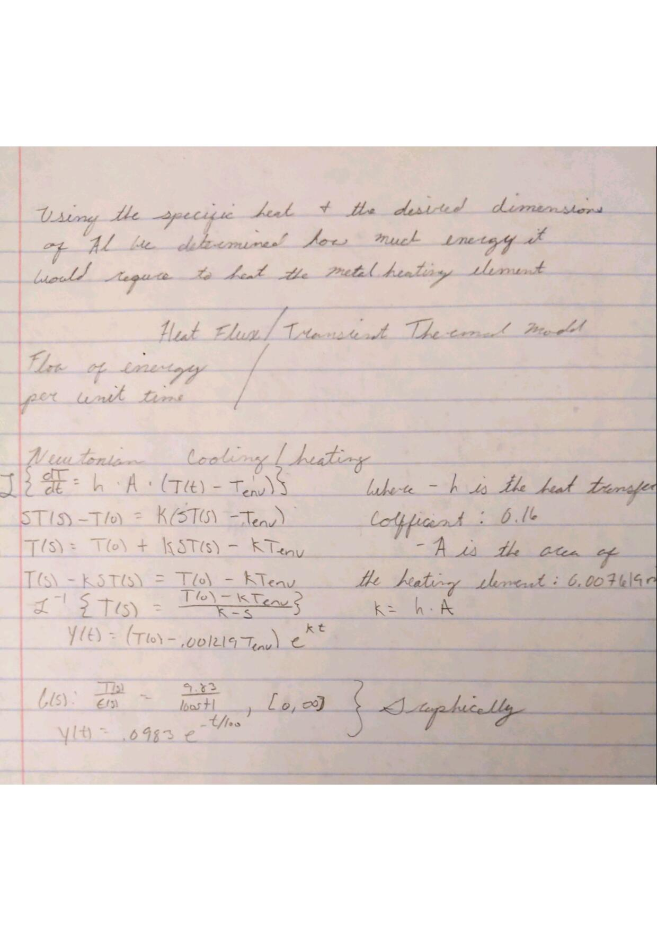
Notes:
Here is the math to explain how I produced the transfer function for both the heat/time but also the heat/voltage.

Slide 13
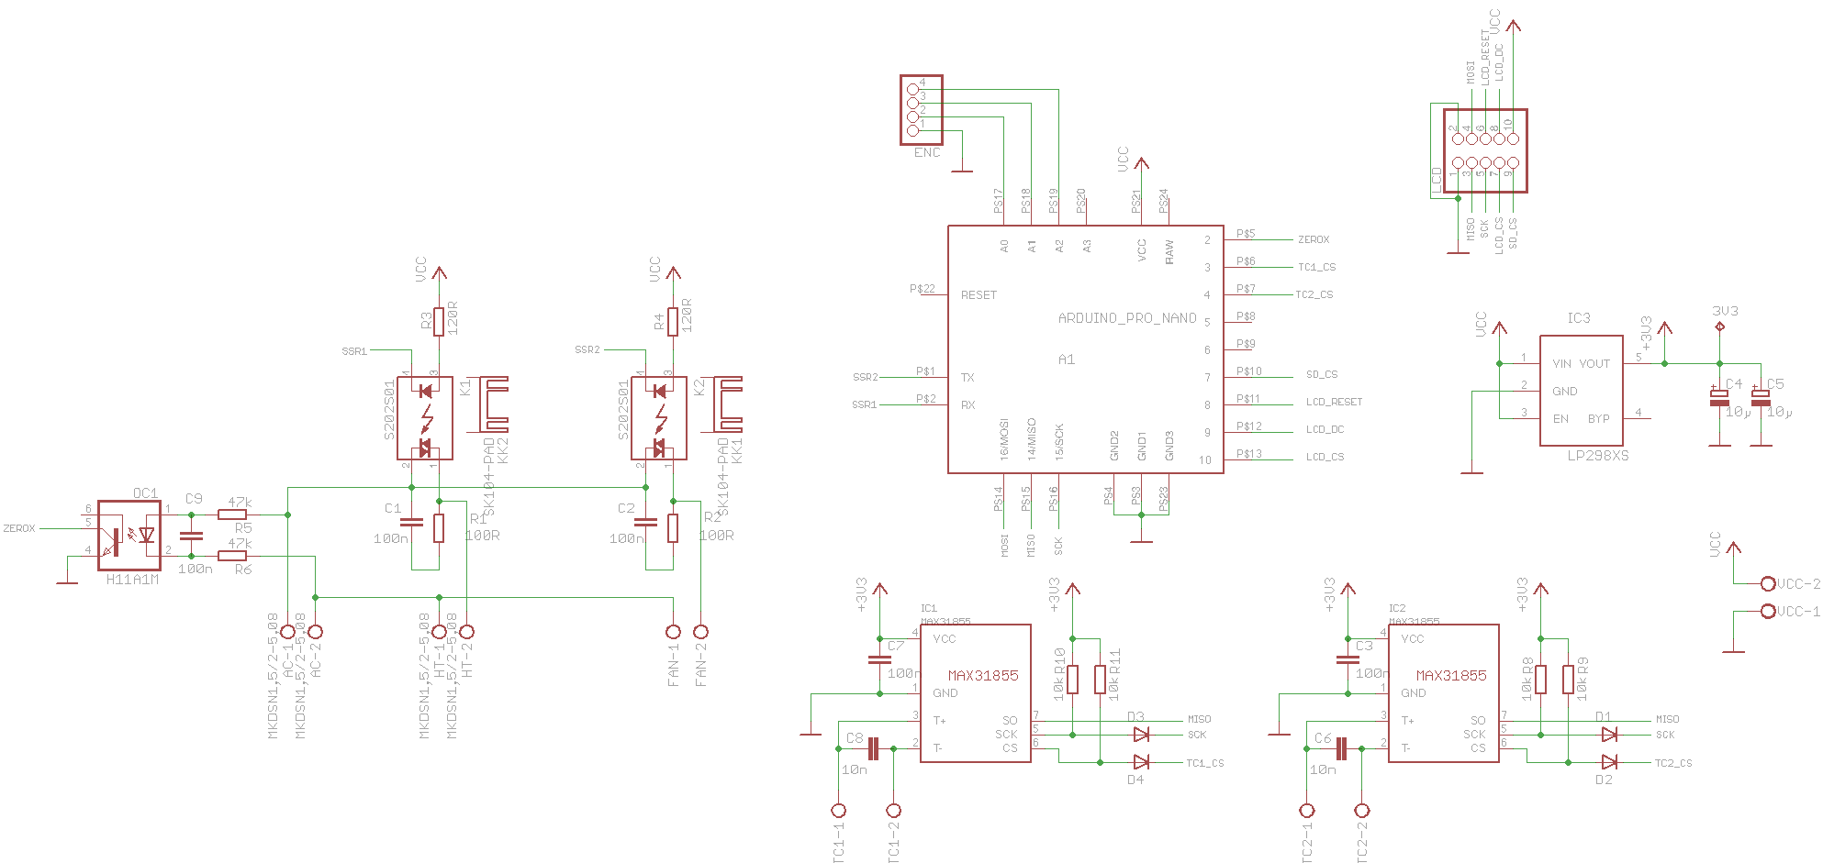
Reflow Oven Controller
A electrical Schmatic of the Reflow Oven Controller with different electrical components including an Adriouno Pro Micro

Slide 14
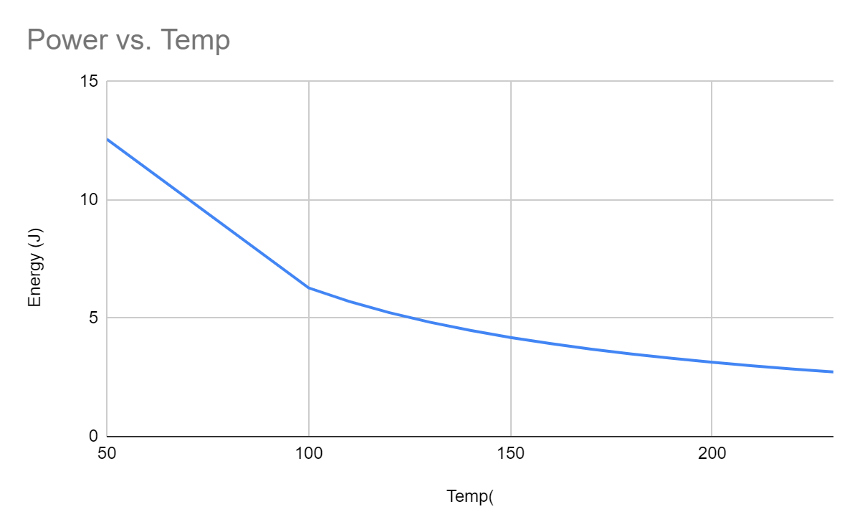
Energy Vs Temp
Notes:
This is a graph showing the amount of energy in joules it takes to raise the aluminum heating plate to a give temperature in celsius.

Slide 15
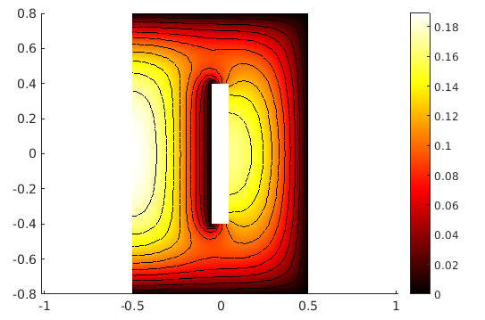
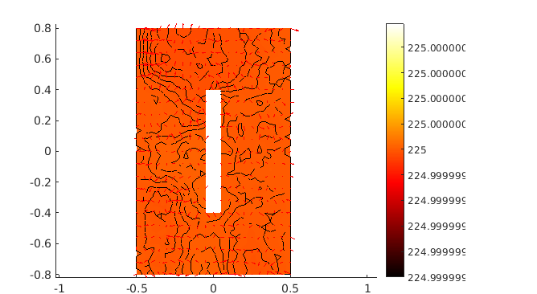
Heat flux/Transient Thermal Model
Notes:
The left if heat flux and the right is the thermal model.

Slide 16
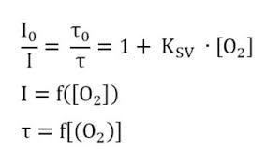
Optical modeling.
Different colors emit different wavelengths of light, so we will be using AI optical sensors and software to determine the size, type, and color of the item to be cooked. It does this in company with several other sensors including thermostat and hygrometer, however, I was unable to come up with a smooth transfer function or differential equation for the optical sensor because the wavelengths of any given object fluctuate greatly.

Slide 17
Project Goals
Display multiple measurements of the dynamic model in a smart toaster oven through MATlab simulations.
Design, build, and test different methods to find most efficient configuration.
Add to the complexity of the system with optical and temperature sensors that will ensure the best cook quality.
Notes:
“The future goals for this project is to create a fully functioning dynamic model that measures: Heat distribution and dissipation, voltage output and as well as transfer function abilities ; and displays the resulting output through MAtlab simulations. In the process, the testing of different methods is vital in finding the most efficient solution. In the end, the complex system with multiple sensors will contribute to a working model that can be used in real applications”

Slide 18
References
https://nypost.com/2019/02/16/toasters-may-expose-you-to-more-pollution-than-a-busy-intersection/
https://www.newyorker.com/magazine/2019/04/08/the-hidden-air-pollution-in-our-homes
“Breville 800 Series Service Manual.” Copyright 2011,2019 Sonic Purity. All Rights Reserved., siber-sonic.com/appliance/breville800sm.html. Accessed 24 June 2021.
Instructables. “Hack a Toaster Oven for Reflow Soldering.” Instructables, www.instructables.com/Hack-a-Toaster-Oven-for-Reflow-Soldering. Accessed 22 June 2021.

